Slide 1
Teradata CoE
Teradata Lab Course
CONTENTS:
1)
2)
3)
4)
5)
Math Functions
OLAP Functions
Substrings and Positioning Functions
Temporal Tables Create function
Temporary Tables

Slide 2
Teradata CoE
Teradata Lab Course
Math Functions

Slide 3
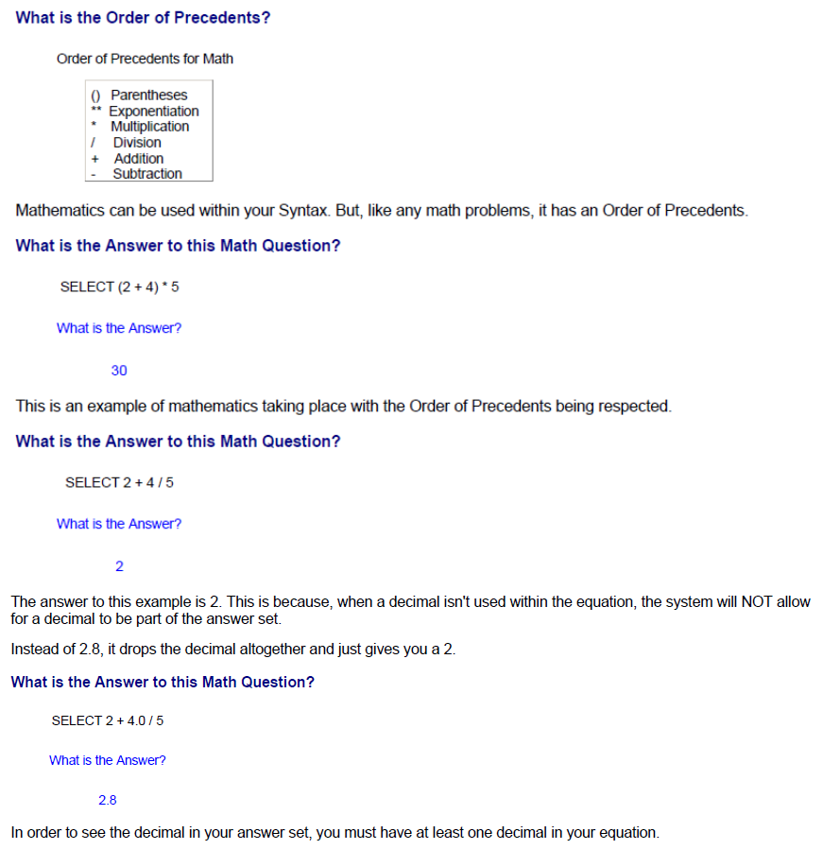
Teradata CoE
Teradata Lab Course
Math Functions

Slide 4
Teradata CoE
Teradata Lab Course
OLAP Functions

Slide 5
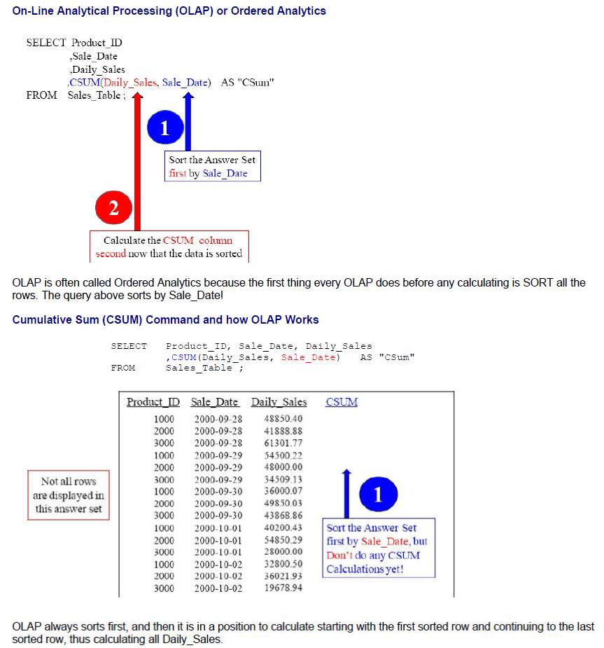
Teradata CoE
Teradata Lab Course
OLAP Functions

Slide 6
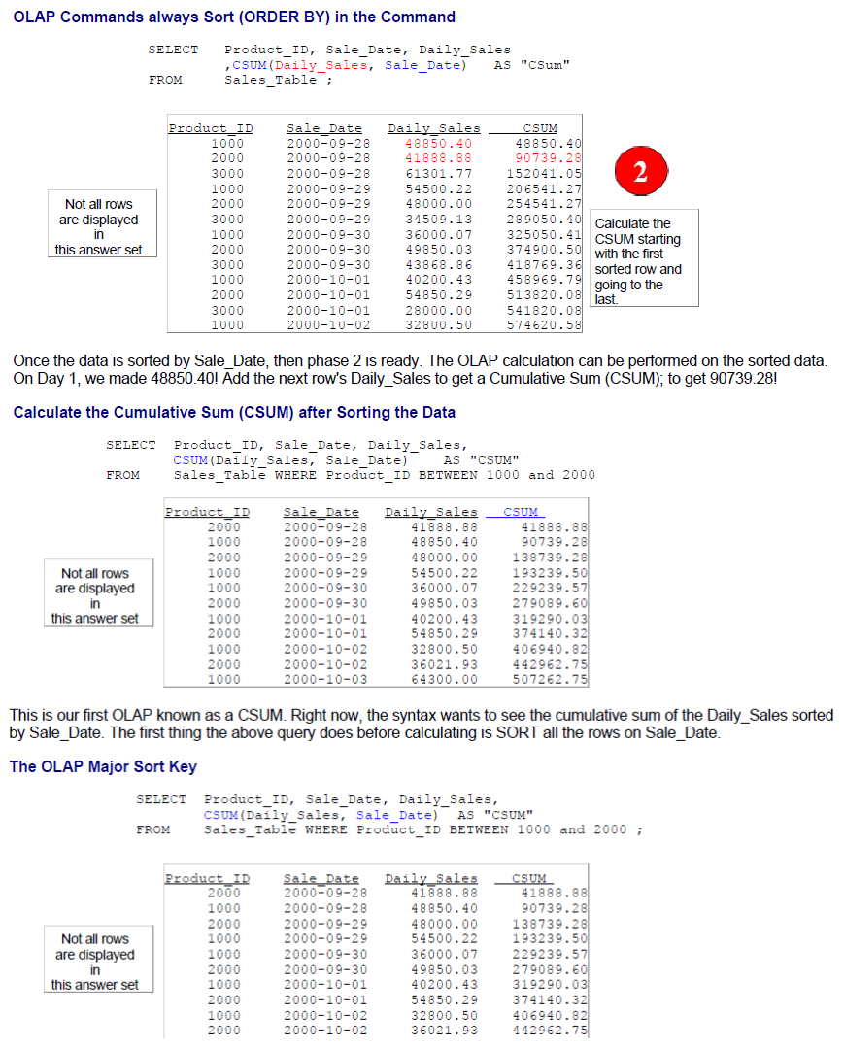
Teradata CoE
Teradata Lab Course

Slide 7
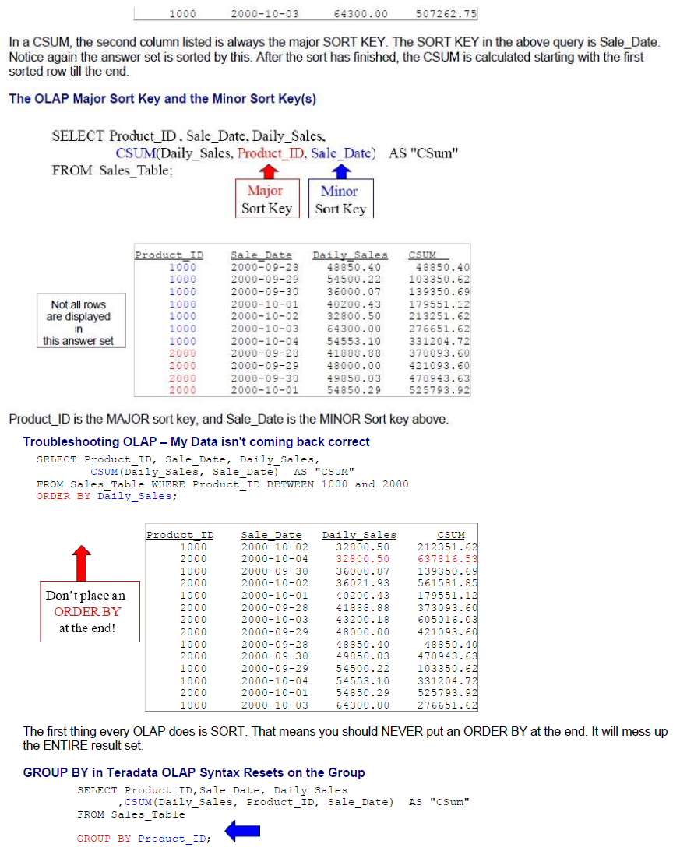
Teradata CoE
Teradata Lab Course

Slide 8
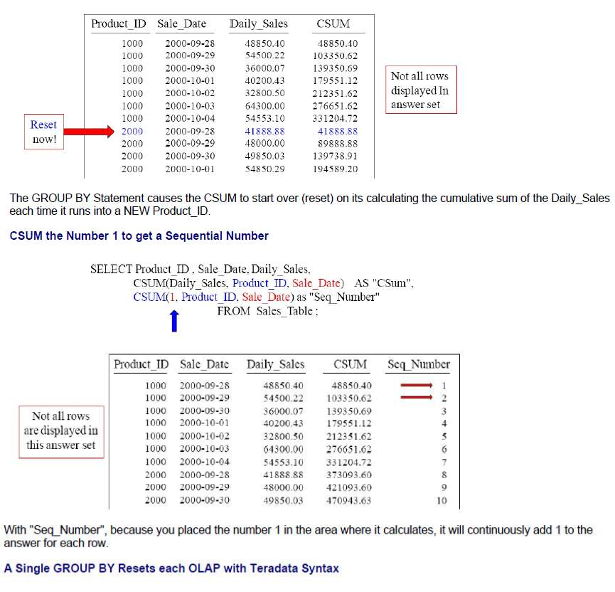
Teradata CoE
Teradata Lab Course

Slide 9
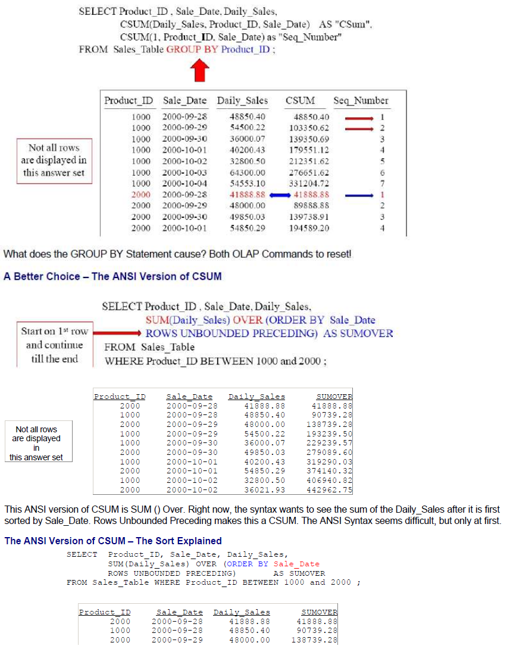
Teradata CoE
Teradata Lab Course

Slide 10
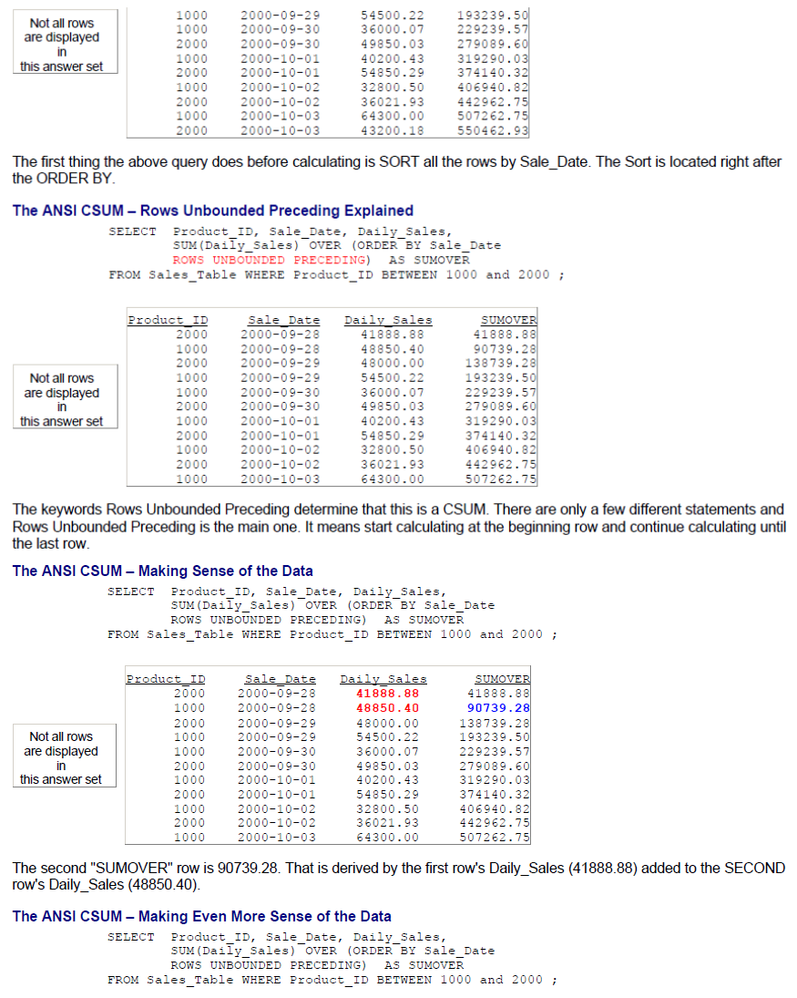
Teradata CoE
Teradata Lab Course

Slide 11
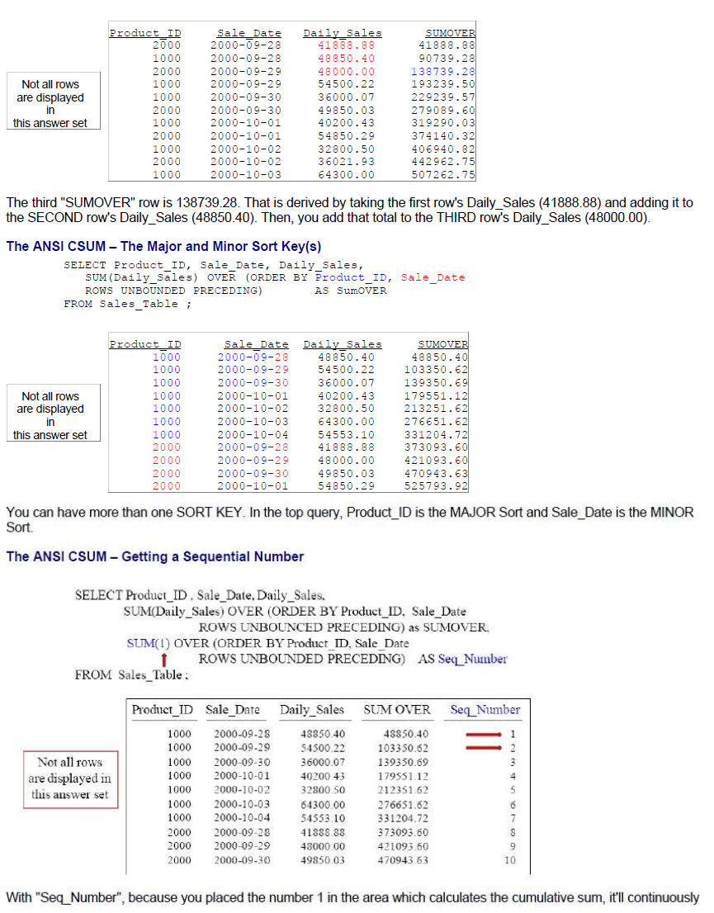
Teradata CoE
Teradata Lab Course

Slide 12
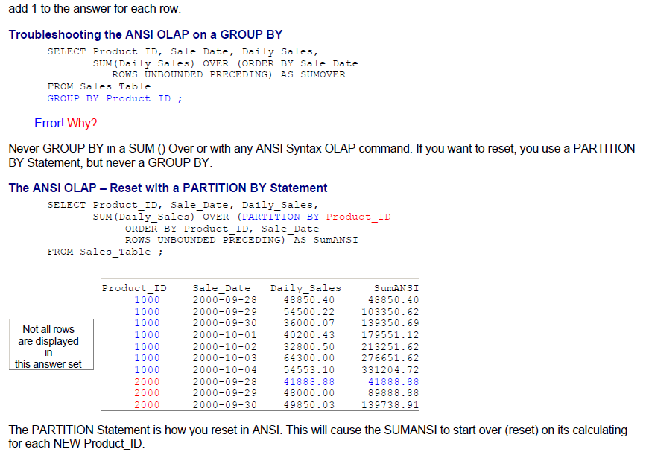
Teradata CoE
Teradata Lab Course

Slide 13
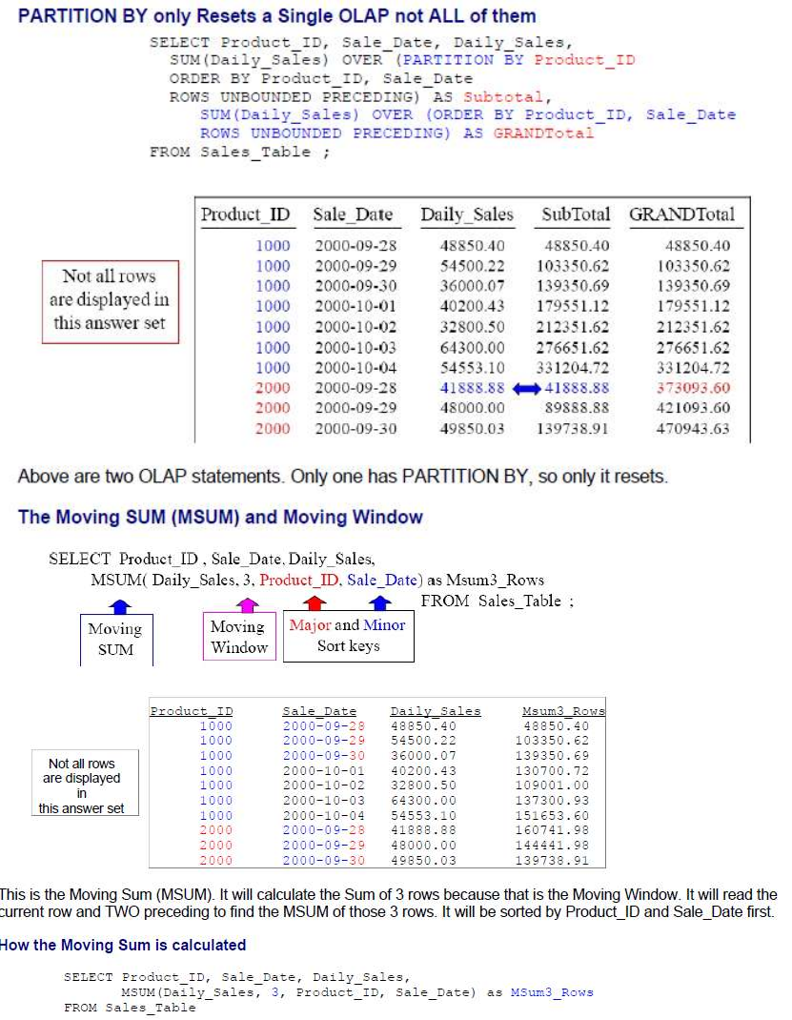
Teradata CoE
Teradata Lab Course

Slide 14
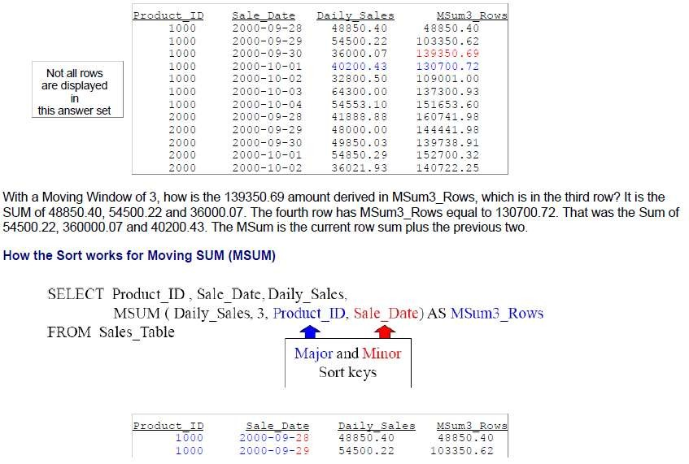
Teradata CoE
Teradata Lab Course

Slide 15
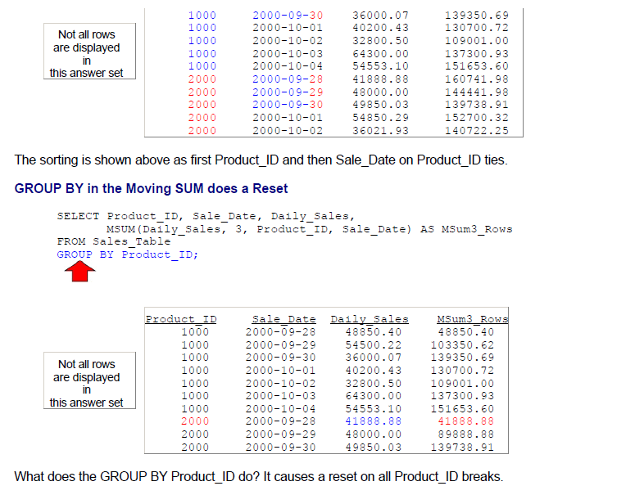
Teradata CoE
Teradata Lab Course

Slide 16
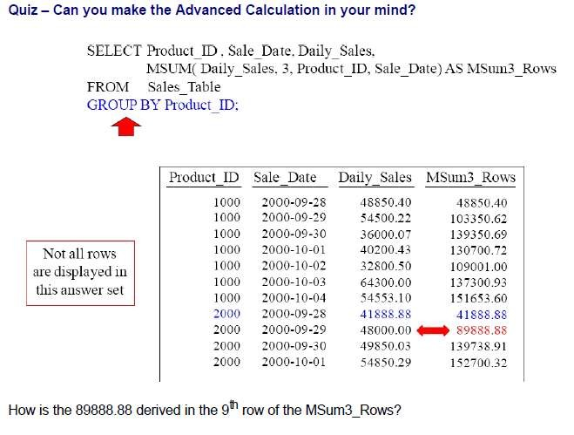
Teradata CoE
Teradata Lab Course

Slide 17
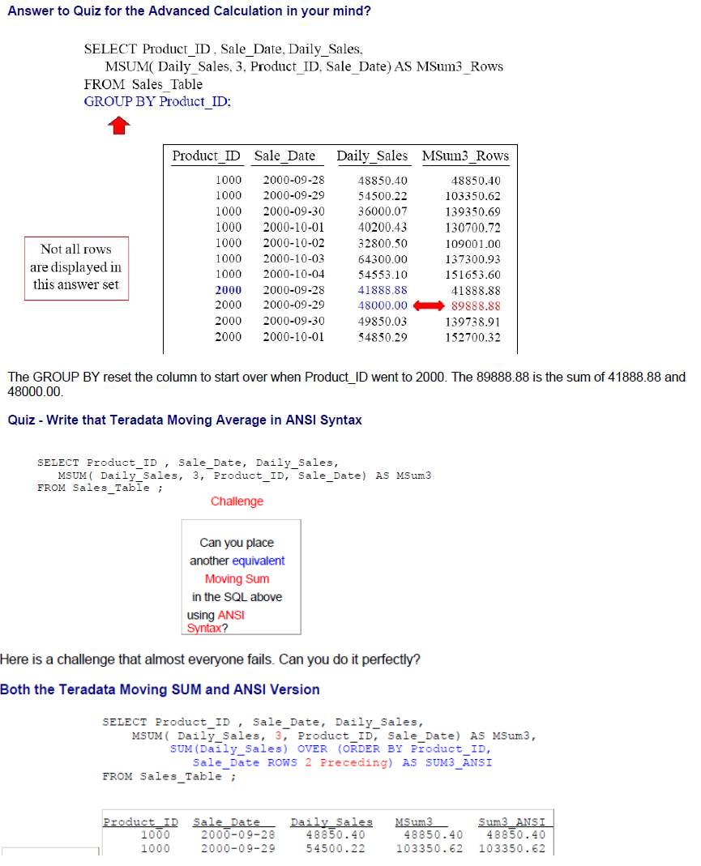
Teradata CoE
Teradata Lab Course

Slide 18
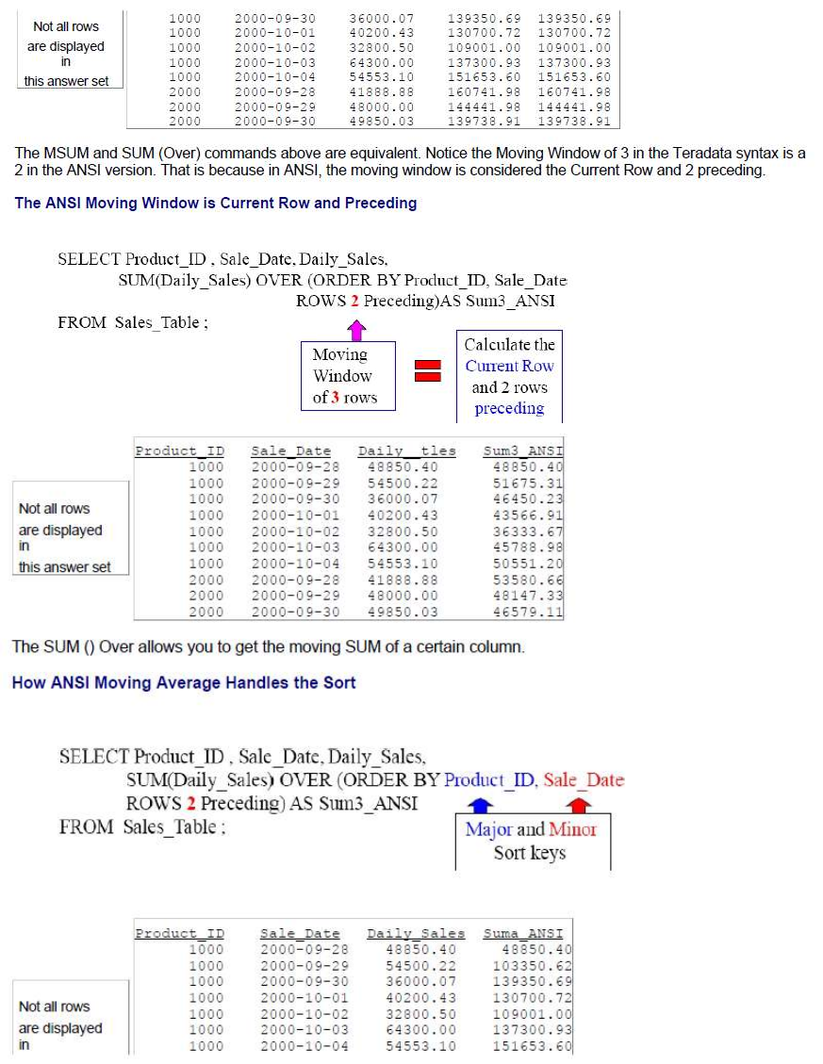
Teradata CoE
Teradata Lab Course

Slide 19
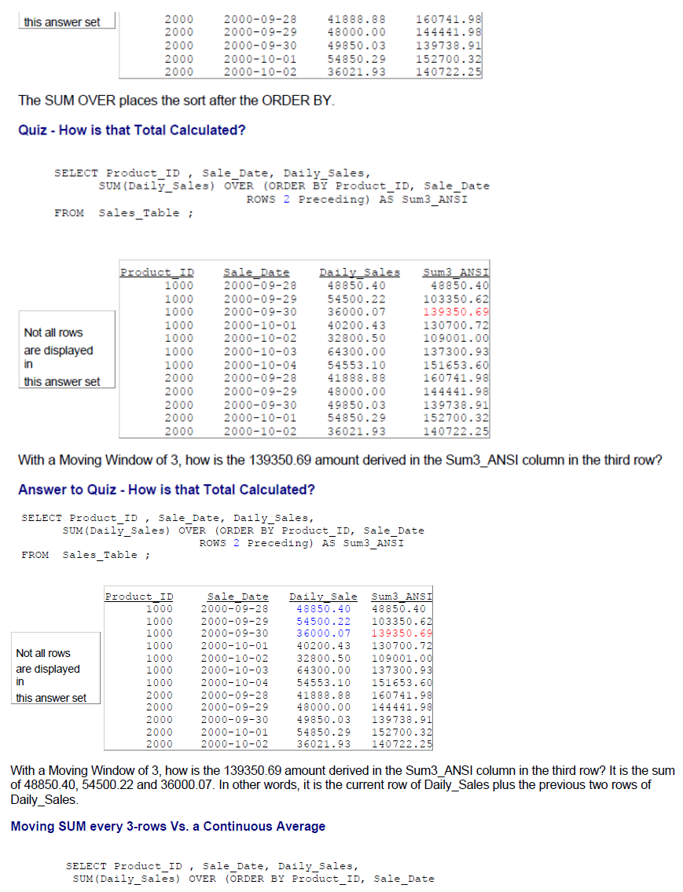
Teradata CoE
Teradata Lab Course

Slide 20
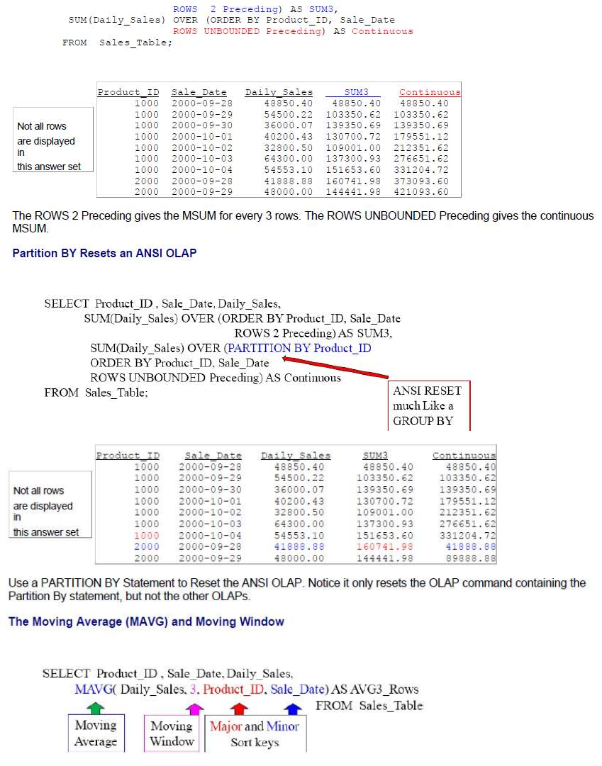
Teradata CoE
Teradata Lab Course

Slide 21
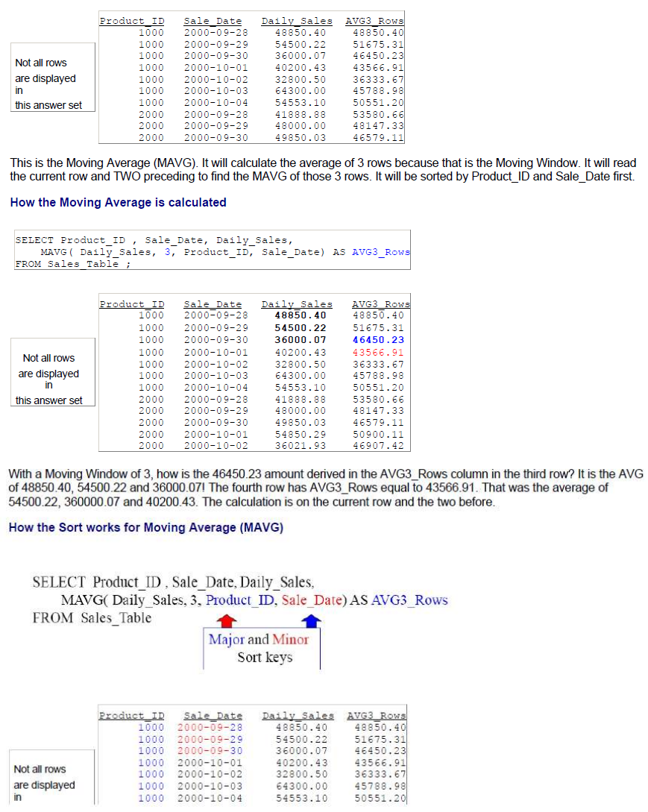
Teradata CoE
Teradata Lab Course

Slide 22
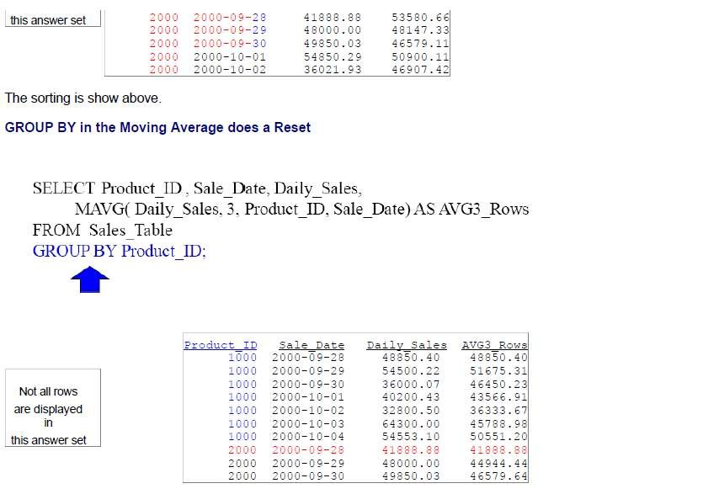
Teradata CoE
Teradata Lab Course

Slide 23
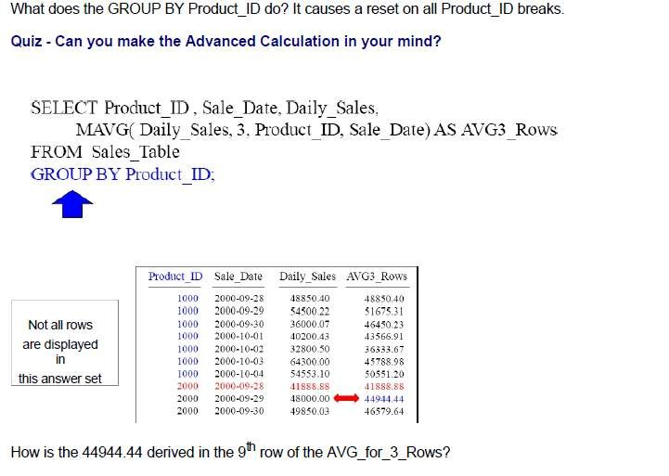
Teradata CoE
Teradata Lab Course

Slide 24
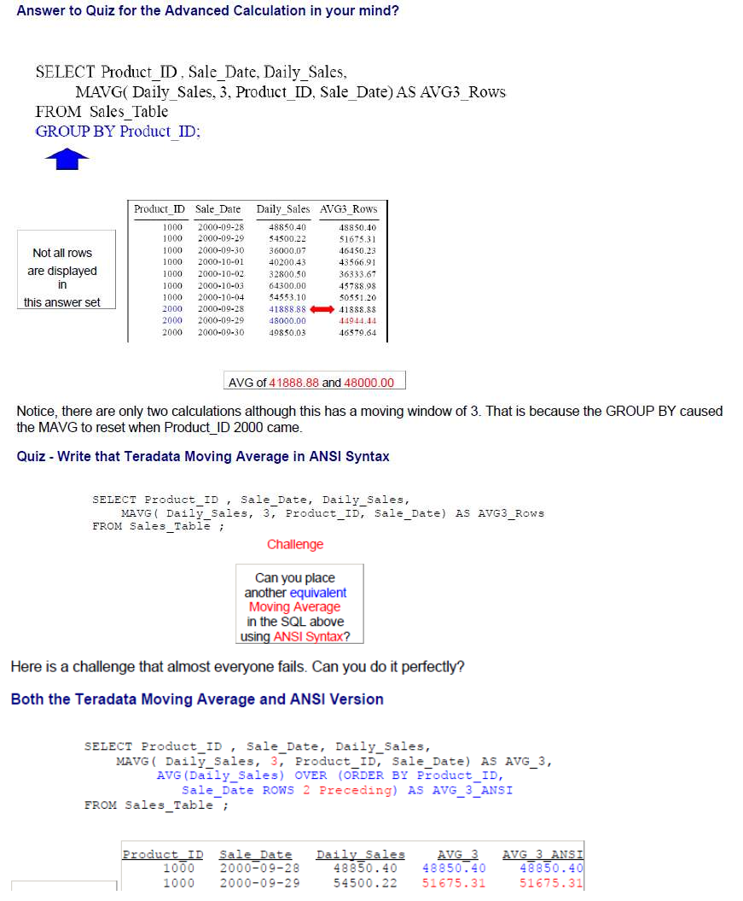
Teradata CoE
Teradata Lab Course

Slide 25
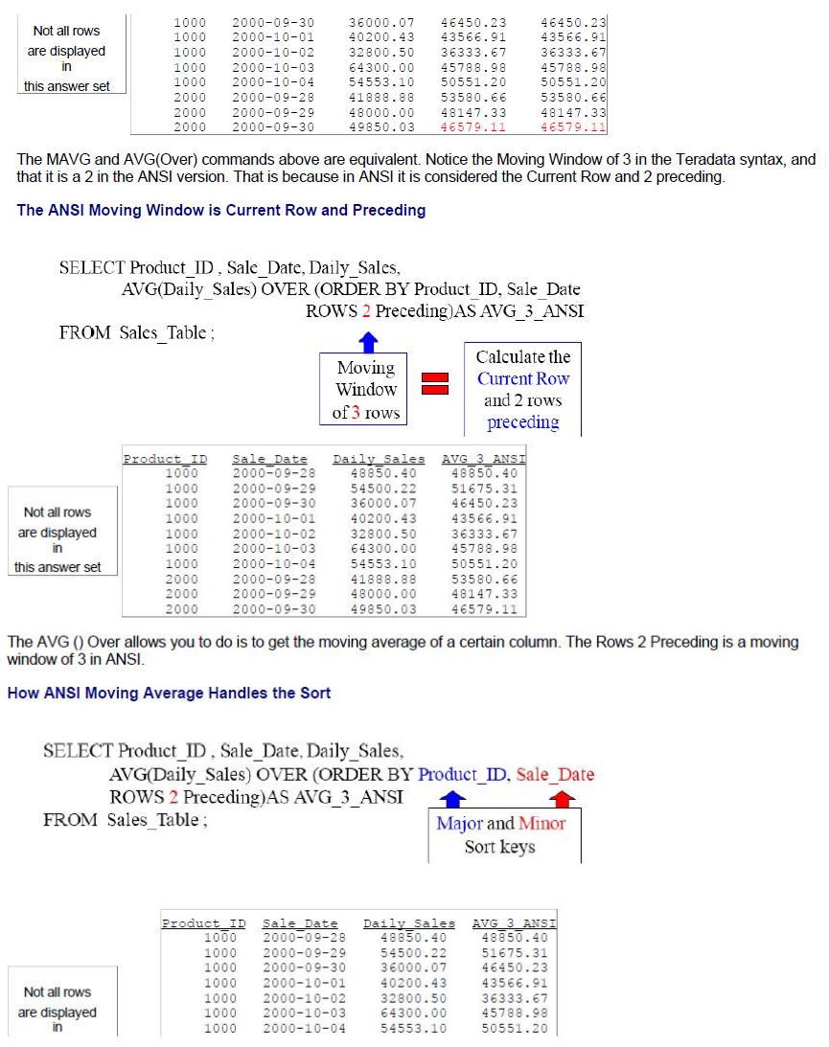
Teradata CoE
Teradata Lab Course

Slide 26
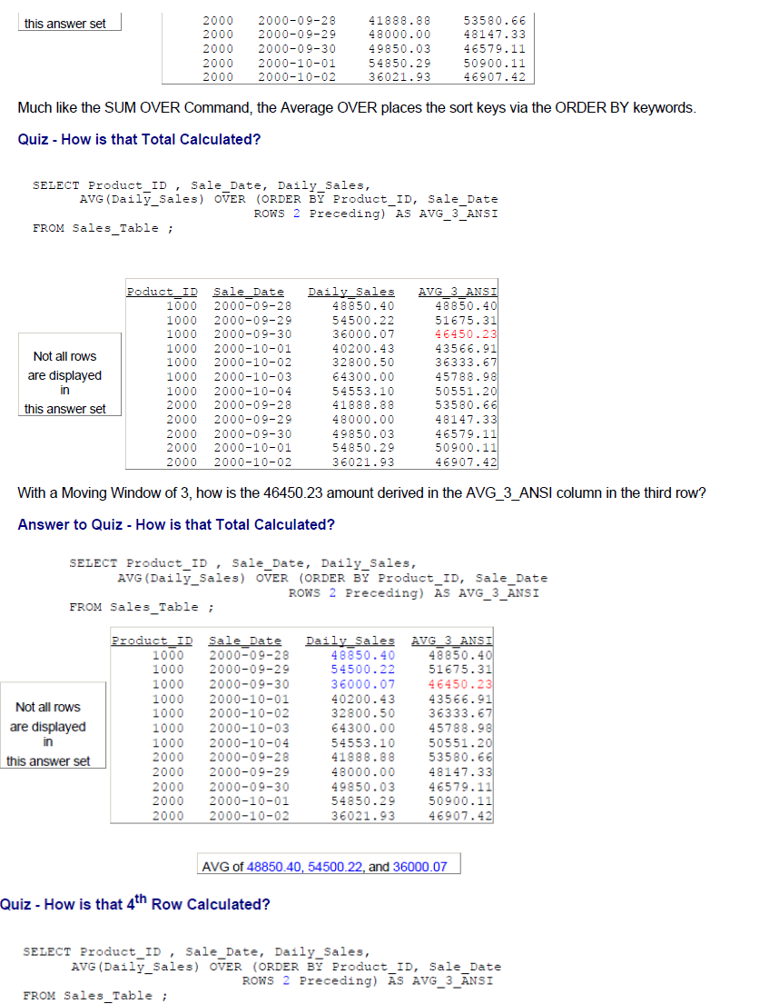
Teradata CoE
Teradata Lab Course

Slide 27
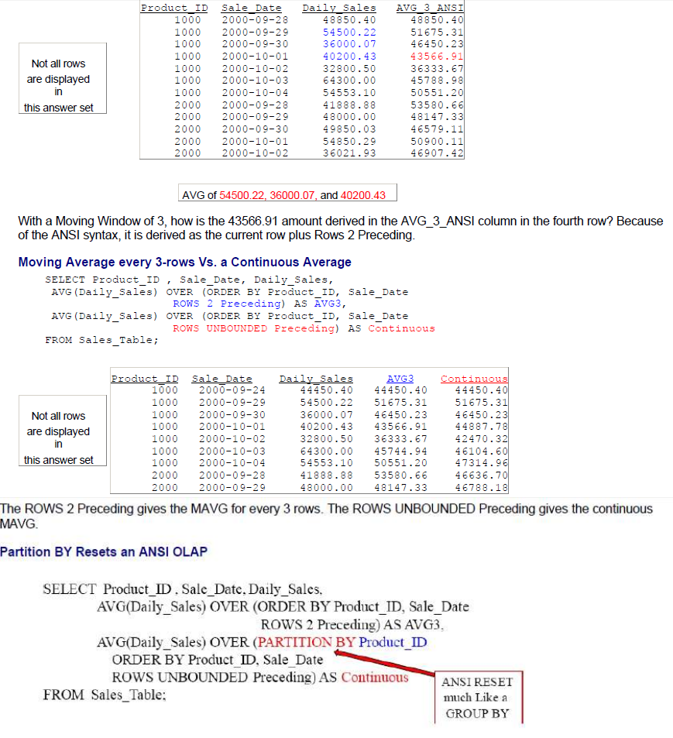
Teradata CoE
Teradata Lab Course

Slide 28
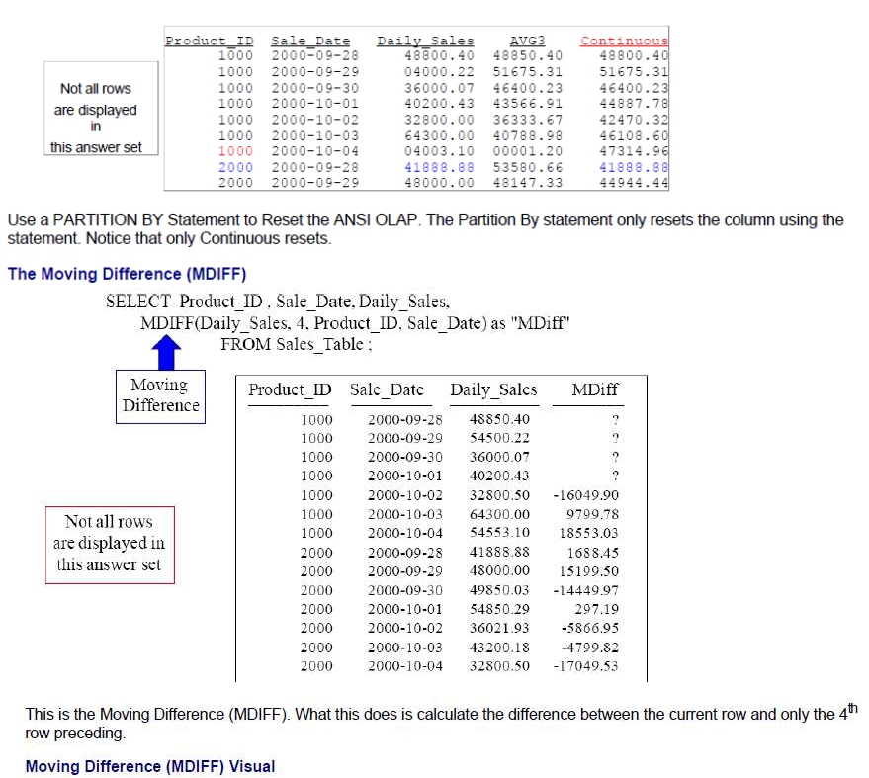
Teradata CoE
Teradata Lab Course

Slide 29
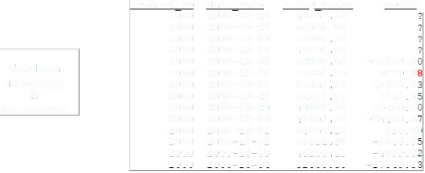
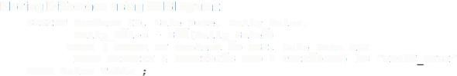
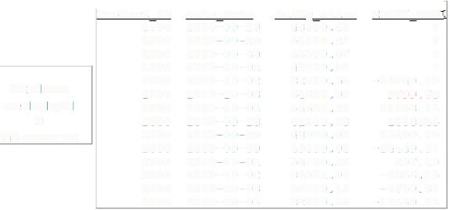
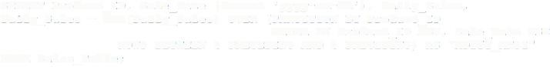
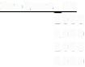
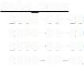
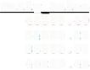
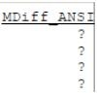

Teradata CoE
Teradata Lab Course
SEL�CT P=ociuct ID, Sale Date, Daily Sales,
MD:?P(:Jai:y Sales,-�, Product Io, Sale_Date)
as "M:>iff"
PROM Sales
'r able -
-
?roduct. ID
1000
1000
1000
1000
1000
1000
1000
2000
2000
2000
2000
2000
2000
2000
Sale Date
Dail;! Sales
MDiff
2000-09-28
2000-09-29
2000-09-30
2000-10-01
2000-10-02
2000-10-03
2000-10-04
2000-09-28
2000-09-29
2000-09-30
2000-10-01
2000-10-02
2000-10-03
2000-10-04
48850.40
54500.22
36000.07
40200.43
32800.50
64300.00
54553.10
41888. 88
48000.00
49850.03
54850.29
36021.93
43200.18
32800.50
Not al rows
are diSplayed
in
this answer set
-16049.9
9799. 7
18553.0
1688.4
15199.5
-H4�9.9
297 .1.
-5866.9
-4799.8
-17049.5
How much more did we make for Product ID 1000 on 2000-10-03 versus Product ID 1000 which was 4 rows earlier on
2000-09-29?
-
-
Moving Difference using ANSI Syntax
SELEC� P=oduct :o, Sale Date, Daily Sales,
OVER (-OR:JER BY ?roduct ID ASC, Sale Date ASC
Daily s�:es - SUM(Dai:y Sale;)
ROWS BEDiEEN 4 PRECEDING AND PROM Sales Table
4 PRECEDING) AS "MDiff ANS:"
Product ID
1000
1000
1000
1000
1000
1000
1000
2000
2000
2000
2000
2000
2000
2000
Sale :iate
2000-09-28
2000-09-29
2000-09-30
2000-10-01
2000-10-02
2000-10-03
2000-10-04
2000-09-28
2000-09-29
2000-09-30
2000-10-01
2000-10-02
2000-10-03
2000-10-04
Dail¥ Sales
48850.40
54500.22
36000.07
40200.43
32800.50
64300.00
54553.10
41888. 88
'!8000.00
49850.03
54850.29
36021.93
43200.18
32800.50
MD.:.ff ANS-
?
?
?
?
-16049.90
9799.78
18553.03
1688 .45
15199.50
-14449. 97
297.19
-5866.95
-<;799.82
-17049.53
Not all rows
are displayed
in
this answer set
This is how you do an MDiff using the ANSI Syntax with a moving window of 4.
Moving Difference using ANSI Syntax with Partition By
SE�ECT Product ID, Sale Date (Format 'yyyy-mm-dd'), Daily sa:es,
Daily Sales - SUM(Da.:.ly-Sales)
OVER (?�..RTIT!ON BY Product-ID
ORDER BY Product ID ASC, Sale Date ASC PRECEDING MID 4 PRECED!NG) J>.S "MDiff_JlliSI"
-
-
ROWS BETWEEN 4
FROM Sales_Tab:e;
Product I:J
Sale Date
Daily Sales
43850.�0
5q500.22
36000.07
40200.43
1000 2000-09-28
1000
2000-09-29
1000 2000-09-30
1000
2000-10-01

Slide 30
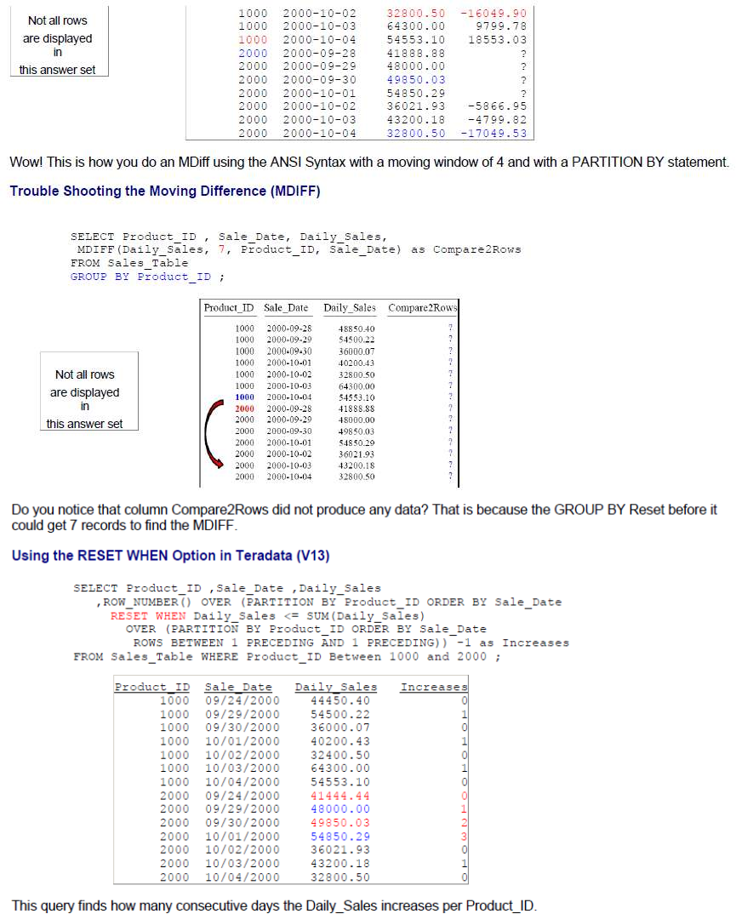
Teradata CoE
Teradata Lab Course

Slide 31
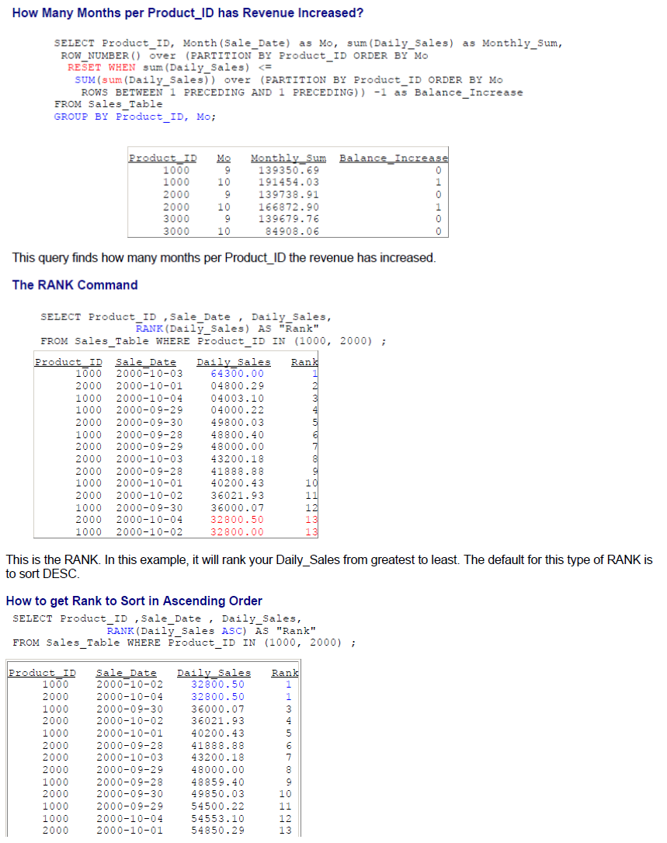
Teradata CoE
Teradata Lab Course

Slide 32
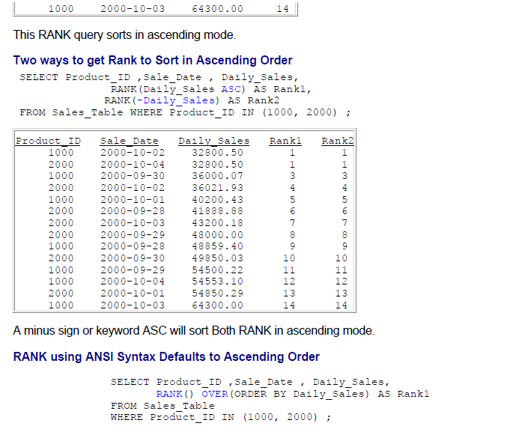
Teradata CoE
Teradata Lab Course

Slide 33
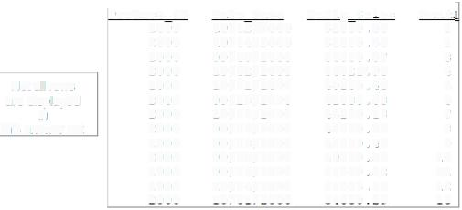
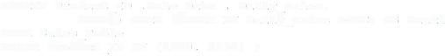
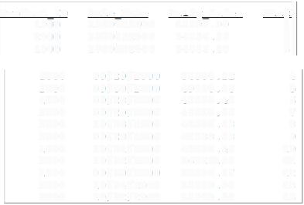
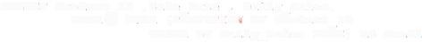
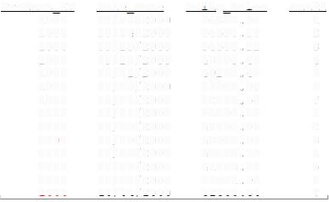
Teradata CoE
Teradata Lab Course
?roduct :D
1000
2000
1000
2000
1000
2000
2000
2000
1000
2000
1000
1000
2000
sa:e Date
10/02/2000
10/0.;/2000
09/30/2000
10/02/2000
10/01/2000
09/28/2000
10/03/2000
09/29/2000
09/28/2000
09/30/2000
09/29/2000
10/04/2000
10/01/2000
Daill,! Sales
32800.50
32800.50
36000.07
36021. 93
40200. 43
41888. 88
43200.18
48000.00
48859. 40
49850.03
54500.22
54553.10
54850. 29
Rank1
1
1
3
4
5
6
7
8
9
10
11
12
13
Not au rows are displayed in
this answer set
This is the RANK() OVER. It provides a rank for your queries. Notice how you do not place anything within the () after the word RANK. Default Sort is ASC.
Getting RANK using ANSI Syntax to Sort in DESC Order
SELECT Product I� ,Sale �ate , Daily Sales,
RANK() OVER (ORDER BY Daily Sales
DESC) AS Rankl
fROM Sales Table
WHERE Prod;ct_ID IN (1000, 2000) ;
-
Product I:>
1000
2000
1000
sa:e :>ate Ja;:!l Sales
""l1
4
5
6
7
8
9
10
11
12
13
13
10/03/2000
10/01/2000
10/04/2000
64300.00
54850.29
54553.10
1000
2000
1000
2000
2000
2000
1000
2000
1000
2000
1000
09/29/2000
09/30/2000
09/28/2000
09/29/2000
10/03/2000
09/28/2000
10/01/2000
10/02/2000
09/30/2000
10/04/2000
10/02/2000
54500.22
49850.03
48850.40
48000.00
,3200.18
41888.88
,0200.43
36021. 93
36000.07
3::800.50
32800.50
Is the query above in ASC mode or DESC mode for sorting?
RANK() OVER and PARTITION BY
SELECT Product ID ,Sale Date, Daily Sales,
RANK() OVER (PARTITIO!" BY Product ID
ORDER BY Oaily_Sales OESC) AS Rankl fROM Sales Tab:e
WHERE Product ID
IN (1000, 2000)
Product I:>
1000
1000
1000
1000
1000
1000
1000
Sale Date
10/03/2000
10/04/2000
09/29/2000
09/28/2000
10/01/2000
09/30/2000
10/02/2000
10/01/2000
09/30/2000
09/29/2000
10/03/2000
09/28/2000
10/02/2000
10/04/2000
Da�l� Sales
6,300.00
5,553.10
54500.22
48850.40
40200.43
36000.07
32800.50
54850.29
49850.03
48000.00
43200.18
41888.88
36021.93
32800.50
Rankl
1
2
3
4
5
6
7
l
::
3
4
5
6
7
::ooo
::ooo
coco
::ooo
::ooo
cooo
:occ

Slide 34
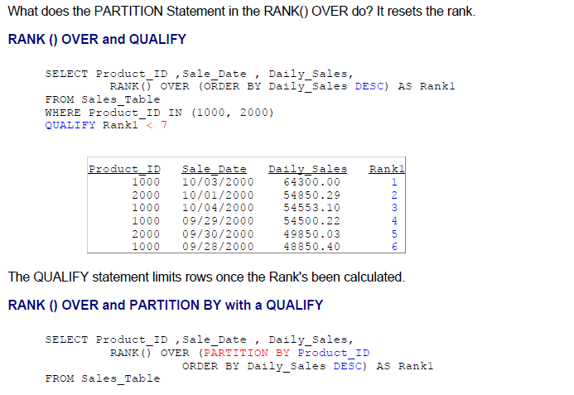
Teradata CoE
Teradata Lab Course

Slide 35
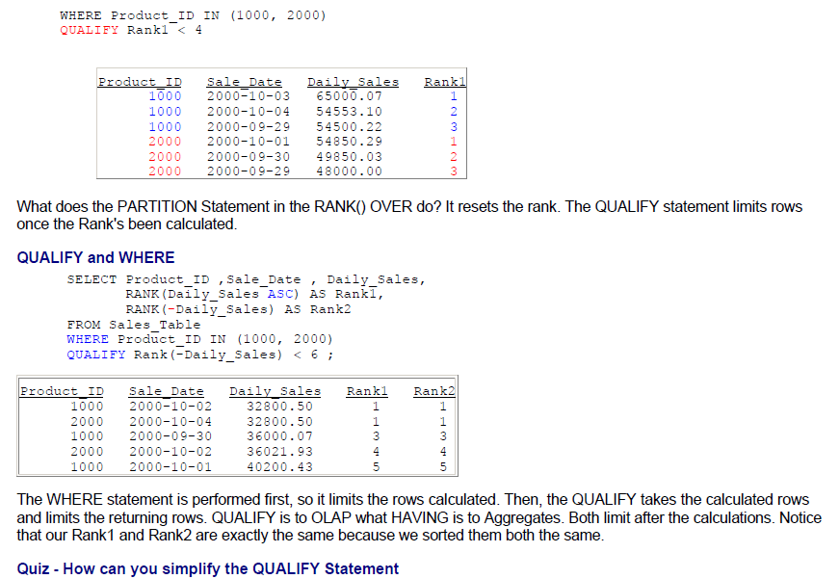
Teradata CoE
Teradata Lab Course

Slide 36
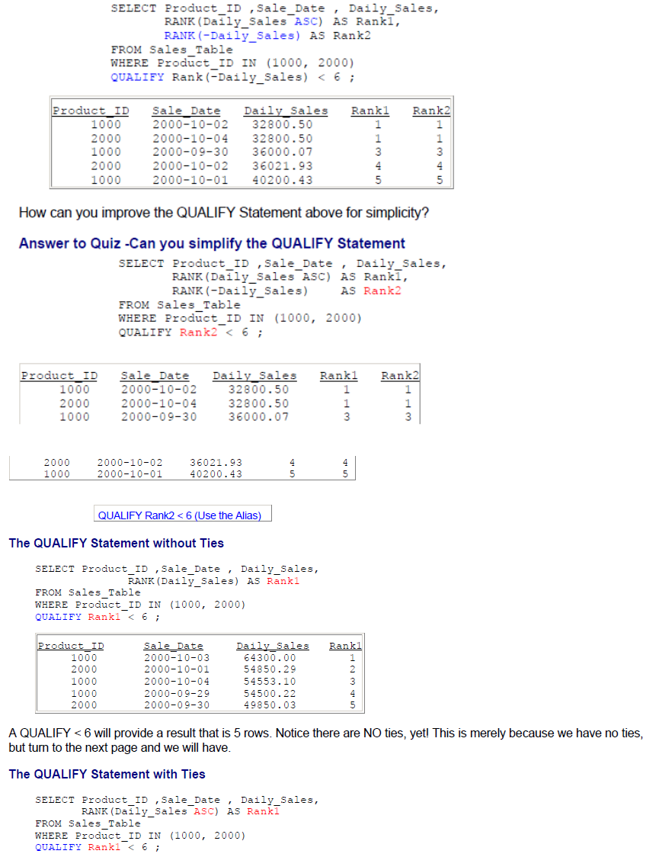
Teradata CoE
Teradata Lab Course

Slide 37
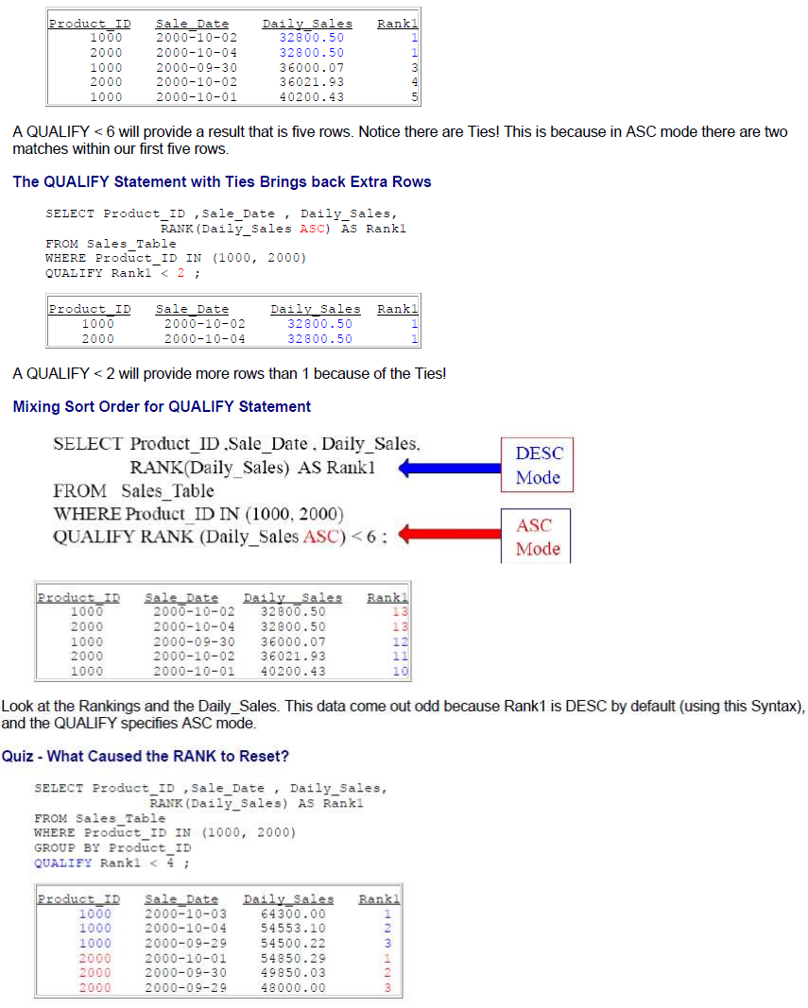
Teradata CoE
Teradata Lab Course

Slide 38
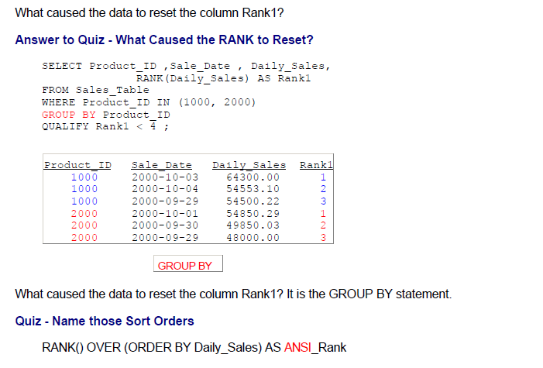
Teradata CoE
Teradata Lab Course

Slide 39
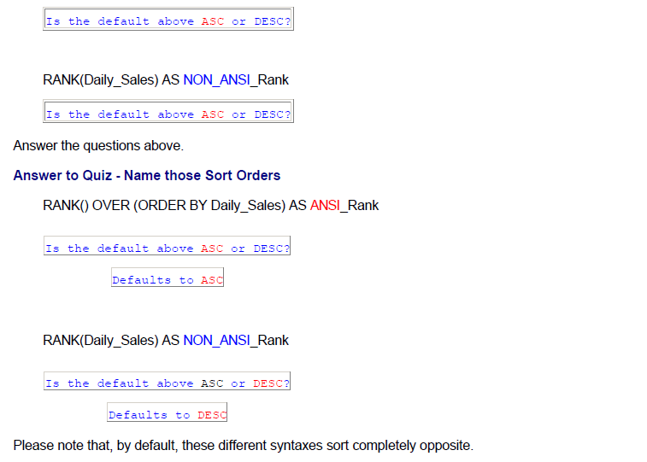
Teradata CoE
Teradata Lab Course

Slide 40
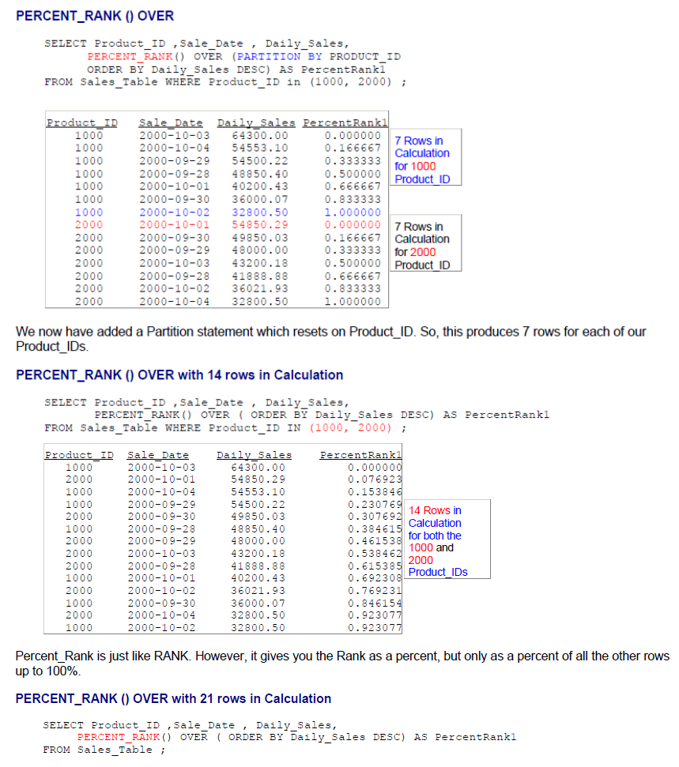
Teradata CoE
Teradata Lab Course

Slide 41
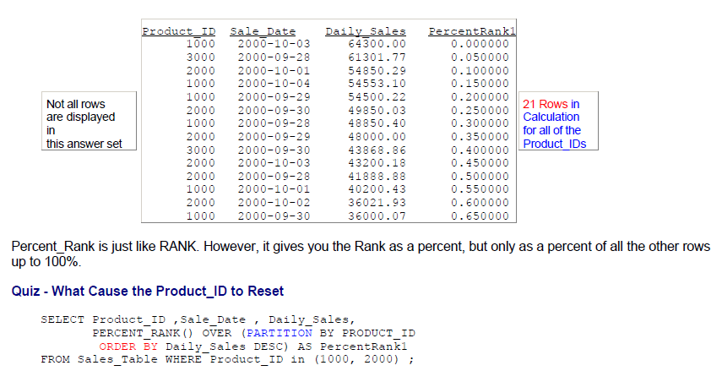
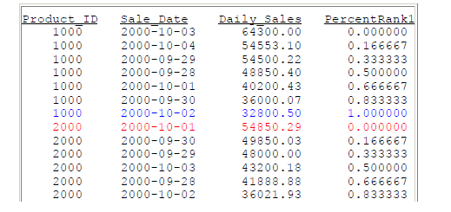
Teradata CoE
Teradata Lab Course

Slide 42

Teradata CoE
Teradata Lab Course

Slide 43

Teradata CoE
Teradata Lab Course

Slide 44

Teradata CoE
Teradata Lab Course

Slide 45

Teradata CoE
Teradata Lab Course

Slide 46

Teradata CoE
Teradata Lab Course

Slide 47

Teradata CoE
Teradata Lab Course

Slide 48






Teradata CoE
Teradata Lab Course
Notall rows are displayed in
this answer set
1000
1000
1000
1000
1000
1000
2000
2000
2000
2000
2000-09-29
2000-09-30
2000-10-01
2000-10-02
2000-10-03
2000-10-04
2000-09-28
2000-09-29
2000-09-30
2000-10-01
54500.22
36000.07
qo200.43
3:300.50
64300.00
54553.10
41888.88
48000.00 q9950.03
54850.29
3:000.5
3:000.5
3'.::800.5
3'.::800.5
3:800. 5
3'.::800.5
32800.5
3:800.5
3:800.5
3'.::800.5
Min only displayed 32800.50 because there is NOT a ROWS UNBOUNDED PRECEDING statement. So, it found the lowest Daily_Sales and repeated it
Finding a Value of a Column in the Next Row with MIN
SELECT Product IO ,Sale Date, Daily Sales, M:N(Daily_Sales)-OVER (PARTITION BY Produet_ID
ORDER B� Product ID, Sale Date
ROWS BETWEEN 1 Follow�ng ;nd 1 Following) AS NextSale
FROM Sales_Table W�ERE ?roduct_ID IN (1000, 2000) ;
:?roduct ID
1000
1000
1000
1000
1000
1000
1000
2000
2000
2000
2000
2000
2000
2000
Sale Date Dailv Sales
NextSale
54500.22
36000.07
40200.43
32800.50
64300.00
54553.10
?
48000.00
49850.03
54850.29
36021.93
43200.18
32800.50
?
2000-09-28
2000-09-29
2000-09-30
2000-10-01
2000-10-02
2000-10-03
2000-10-04
2000-09-28
2000-09-29
2000-09-30
2000-10-01
2000-10-02
2000-10-03
2000-10-04
48850.40
5q500.22
36000.07
40200.q3
32800.50
64300.00
54553.10
41888.88
48000.00
49850.03
54850.29
36021.93
43200.18
32800.50
The above example finds the value of a column in the next row for Daily_Sales. Notice it is partitioned, so there is a Null value at the end of each Product_lD.
Finding a Value of a Date in the Next Row with MIN
SELECT Product IO ,Sale Date , Daily Sa:es,
MIN(Sal; Date) OVER (PART:TION BY P�oduct :D
ORDER BY Product :o, Sale Date
-
ROWS BETWEEN 1 co:lowing ;nd l Fol:ow�ng) AS NextDate
FROM Sales_Table WHERE Product_I� IN (1000, 1000) ;
DY�.-,,,�� ID
1000
1000
1000
1000
1000
1000
1000
2000
2000
2000
2000
2000
2000
2000
�A¹S:: I2Ak� '2A�l:X: �Al��
.tiS::��llAiS::
091:91:000
091301:000
101011:000
101021:000
101031:000
101041:000
�
091:91:000
091301:000
101011:000
101021:000
101031:000
101041:000
?
2000-09-28
2000-09-29
2000-09-30
2000-10-01
2000-10-02
2000-10-03
:000-10-04
2000-09-28
2000-09-29
2000-09-30
2000-10-01
2000-10-02
2000-10-03
2000-10-04
48850.40
54500.22
36000.07
40200.43
32800.50
64300.00
54553.10
41888.88
48000.00
49850.03
54850.29
36021.93
43200.18
32800.50
The above example finds the value of a column in the next row for Sale_Date. Notice it is partitioned, so there is a Null

Slide 49









Teradata CoE
Teradata Lab Course
value at the end of each Product_lD.
Finding Gaps between Dates
SELECT Product Id ,Sale Date
,M!N(Sal;_Jate) OVER (PARTITION BY Product_Id ORDER BY Sale Date
ROWS BETWEEN 1 F-OLLOWHIG JI_ND U1"BOUt;DED E"O::.LOWING) AS jate Of Next Row
,Date Of Next Row - Sale Date �s jays To Next Row
FROM Sales Table-WHERE ?roduct_!D Between 1000 a;d 2000;
Product ID
1000
1000
1000
1000
1000
1000
1000
2000
2000
2000
2000
2000
2000
2000
Sale Date
10/04/2000
10/03/2000
10/02/2000
10/01/2000
09/30/2000
09/�9/2000
09/�8/2000
10/04/2000
10/03/2000
10/02/2000
10/01/2000
09/30/2000
09/29/2000
09/28/2000
Date Of Next
?
10/04/2000
10/03/2000
10/02/2000
10/01/2000
09/30/2000
09/29/2000
7
10/04/2000
10/03/2000
10/02/2000
10/01/2000
09/30/2000
09/29/2000
Row
Da�s To
Next Row
?
l
1 l l
1
1
?
1
1
1
1
1
1
The above query finds gaps in dates.
The CSUM for Each Product_lD for the First 3 Days
SELECT ROW NUMBER() OVER (PARTIIION BY Product_ID ORDER BY Sale_Date) As Row_Nbr
Product Id, Sale Date
MIN(Sal;_Date) OVER (PARTIIION BY Product ID OR::>ER BY Sale Date ROWS BETWEEN 1
FOLLOW:NG A.�D 1 F-0::.LOW:NG) As Next_Start_Dt
Daily Sales
SUM(D�ily_Sales) OVER (PARTITION BY Product ID ORDER BY Sale Date
ROWS UNBOUNDED PRECE::>I�G) As To Date-Revenue
FROM Sales Table
QUALIFY Row Nbr <= 3
Row
Nbr
1
2
3
1
2
3
1
2
3
Product ID
1000
1000
1000
2000
2000
2000
3000
3000
3000
Sale Date
09/28/2000
09/29/2000
09/30/2000
09/28/2000
09/29/2000
09/30/2000
09/28/2000
09/29/2000
09/30/2000
Next Start.
09/29/2000
09/30/2000
10/01/2000
09/29/2000
09/30/2000
10/01/2000
09/29/2000
09/30/2000
10/01/2000
:)t
Dail� Sa1es To Date
Revenue
48850.40
5,500.22
36000.07
41888. 88
48000.00
49850.03
61301.77
3,509.13
43868.86
�8850.40
103350.62
139350.69
,1888.88
89888.88
139738.91
61301.77
95810.90
139679.76
The above example shows the cumulative SUM for the Daily_Sales for the first three days for each of our Product_lDs.
Quiz - Fill in the Blank
SELECT Product ID ,Sale Date , Daily Sales,
MIN(Daily_Sales)-OVER (P�.RTITION BY Product ID
ORDER BY ?roduct_!J,-Sale_Jace
ROWS UNBOUNDED PRECEDING) AS MinOVer
FROM Sales_Table WHERE Producc_ID IN
(1000, 2000)
Sale Pats
1000 2000-09-28
Daily sa1e;:s
48850.40
54500.22
36000.07
MipOy5r
48850.40
48850.40
36000.07
1000
1000
2000-09-29
2000-09-30

Slide 50

Teradata CoE
Teradata Lab Course

Slide 51

Teradata CoE
Teradata Lab Course

Slide 52

Teradata CoE
Teradata Lab Course
A Second Typical Rows per Value Query on Sale_Date

Slide 53

Teradata CoE
Teradata Lab Course

Slide 54

Teradata CoE
Teradata Lab Course

Slide 55
Teradata CoE
Teradata Lab Course
Substrings
and Positioning Functions

Slide 56

Teradata CoE
Teradata Lab Course
Substrings and Positioning Functions

Slide 57

Teradata CoE
Teradata Lab Course

Slide 58







Teradata CoE
Teradata Lab Course
Hare:ison Jones Larkins Reilly Smith Smythe Strickling
8
5
7
6
5
6
!O
The TRIM command will trim off any spaces before and after the Last_name.
CHARACTERS and CHARACTER_LENGTH equivalent
SELECT First Name
,C:iAR.�CTERS(F�rs� Name) AS C_tength
FROM Em lo ee Table;
Query2
SE�ECT First Name
,C:iA.RACTER_Leng�h(�irs�_Name) AS C_Lengt
FROM Em lo ee Tab:e;
These two queries will get you the SAME EXACT answer set in your report
OCTET_LENGTH
Query 1
SELECT First Name
,CH�..RACTER(First_Name) AS C_Lengt
FROM Em lo ee Table;
Query2
SE�ECT First Name
,C:iARACTE� Leng�h(First Name) AS C_Lengt
PROM Em lo-ee Table ; -
Query3
SELECT First Name
,Octet �ength(Pirst Name) AS C_Lengt
FROM Ein lo ee Table - ;
You can also use the OCTET LENGTH command. These three queries get the same exact answer sets! Query 2 and 3
are ANSI Standard.
The TRIM Command trims both Leading and Trailing Spaces
Query 1
SELECT Last Name
,Trirn(Last Name) AS No_Space
FROM Em lo-ee Table
Query2

Slide 59

Teradata CoE
Teradata Lab Course

Slide 60

Teradata CoE
Teradata Lab Course

Slide 61

Teradata CoE
Teradata Lab Course

Slide 62

Teradata CoE
Teradata Lab Course

Slide 63

Teradata CoE
Teradata Lab Course

Slide 64

Teradata CoE
Teradata Lab Course

Slide 65







Teradata CoE
Teradata Lab Course
F- rs'C Name v;t:.a":.sUF
Sqtaggy John Richard Herbert.
Mandee
Cletus
William
Billy
!.ora:.ne
In our example above, we start in position 3, but we go for zero positions so nothing is delivered in the column. That is what's up!
An Example using SUBSTRING, TRIM and CHAR Together
CHAR(20)
SELECT Last Name
.SUBSTRING(La�t_Name FRO:t'1
CHARACTERS( TRI'.\1 {TRAILING FROM Last_Name)) ·I FOR 2) AS Letters
FROM Employee_Table:
Lsi:i!. HAm�
Jones
Smi-ch Smythe Harr:.son
Chambers
Stricklin,i
Reil:y
Coffing
:,ark:.ns
,�t:t�·�
th he on z s
ng ly ng ns
es
The SOL above brings back the last two letters of each Last_Name, even though the last names are of different length. We first trimmed the spaces off of Last_Name. Then we counted the characters in the Last_Name. Then we subtracted two from the Last_Name character length, and then passed it to our substring as the starting position. Since we didn't give an ending position in our substring it defaulted to the end.
SUBSTRING and SUBSTR are equal, but use differe,nt syntax
Query 1
SELECT First Name,
SUBS7RING(Fi;st Name FRO� 2 for3) AS Qui
FROM Em lo cc 7ablc ;
Query2
SE�ECT First. Name,
FROM lo e; Table ·
SUBSTR(First.-Narne, 2 ,3) AS Quiz
Both queries above are going to yield the same results! SUBSTR is just a different way of doing a substring. Both have
two parameters in starting position and number of character length.
The POSITION Command finds a Letters Position
SE�ECT Last �ane
,?os��:.or-('e' n Last Nane) AS Find The E
,?os��ion('f' n Last=Nane) AS Find The F
?ROM �r-ployee Tab:e

Slide 66
















Teradata CoE
Teradata Lab Course
c is in 4t1i
position
LastName
Jones
Smith
Smythe
Harrison
Chambers Strickling Reilly Coffing Larkins
Find_Tue_E
4
0
6
0
6
0
2
0
0
Find_Tue_F
0
0
0
0
0
0
0
3
0
Nofisin
the name
e is2r.d
position in
name
l"fi.s in
3rd position
This is the position counter. What it will do is tell you what position a letter is on. Why did Jones have a 4 in the result set? The 'e' was in the 4th position. Why did Smith get a zero for both columns? There is no 'e' in Smith and no 'f in Smith. If there are two 'fs' only the first occurrence is reported.
The POSITION Command is brilliant with SUBSTRING
SE:..ECT Dept No
,Jepartment Name as Jepty
,SU3STR(JeptJ,1 , ?OSIT:OK(' ' IN Jcpartreent_Nane) -1) as Wordl
FROM Department Table;
SE:..ECT Dept_Xo
,Jepa=tment Name as Jepty
,SUBSTR:NG(J;pty ?ROM 1 ;-OR ?OSITION(' ' IN Jepart�ent_Na.ne) -1) as Wo=dl
FROM Department Table;
Dept No
200
100
Depty
Research and Develop Research
Marketing
�a=ket�ng
400
300
500
Custome= Suppo=t
Sales
Suman Resou=ces
Custocer
sa:es
Eun.an
What was the starting position of the Substring in the above query? It was one. The ending position (FOR length) was calculated to look for the first space and then subtract 1. So for "Research and Develop" the starting position was one and for 9-1 = 8.
Quiz - Name that SUBSTRING Starting and For Length
SE�ECT Dept_No
,Department �a�e as Depty
,SUBSTRIXG(Jepty PROM 1 c-OR POSlT:ON(' ' IN Jepartoent_Nane) -1) as Wo=dl
FROM Department Table;
Dept No Deoty
Research and �evelop
Wordl Research Marketing Custome= Sales
:3.uman
200
100
400
300
500
Marketing Customer Support Sales
Human Resources
Marketing (FRO!-'.
E'OR
Research and Jevelop (FROM
FOR
Sales (FROM
FOR
)
Customer Support (;RO!-'.
FOR
)
Human Resources (PROM� POR -i-
Fill in the number for the FROM and the FOR numbers above for each row. Next page!
The POSITION Command is brilliant with SUBSTRING
SELECT Dept_Xo
,�epartment Name as �epty
,SUBSTR(Jepty,l , ?OSlT:ON(' ' IN Depart�ent_Naoe) -1) as Wordl
FROM Department_Table;

Slide 67

Teradata CoE
Teradata Lab Course

Slide 68

Teradata CoE
Teradata Lab Course

Slide 69

Teradata CoE
Teradata Lab Course

Slide 70









Teradata CoE
Teradata Lab Course
First Nane
Squiggy
Last Name rull Name
Jones
Squigay Jones
See those II? Those represent concatenation. That allows you to combine multiple columns into one column. The II (Pipe
Symbol) on your keyboard is just above the ENTER key. Don't put a space in between, but just put two Pipe Symbols
together.
In this example, we have combined the first name, then a single space, and then the last name to get a new column called 'Full name', like Squiggy Jones.
Concatenation and SUBSTRING
SELECT First Name
APetiod (.) and
a �pace
. Substring(First_Name. 1. 1) JI •_{'. ' II Last Name}
.Last Name
FROM Employee_Table
WHEREFirst_Name = 'Squiggy'
as Full Name
First Name
Squ:..ggy
Las't Name
Jones
F'ul 1 Name
S. Jones
Of the three items being concatenated together, what is the first item of concatenation in the example above? It is the first initial of the First_Name. Then we concatenated a literal space and a period. Then we concatenated the Last_Name. Notice that the report shows only three columns.
Four Concatenations Together
SELECT First Name � I VAR.HAR I
.Last Xame J
,TRD.l(Last_Kmue) '' Substri11g(First_Name, l, 1) ' AS Last Kame l st
FROM Employee Table
WHERE First_Kame = 'Squiggy' :
First Name
Squiggy
T,ast Nar-ce
Jones
Last Name lst
Jones S.
Why did we TRIM the Last_Name? To get rid of the spaces or the output would have looked odd. How many items are being concatenated in the example above? There are 4 items concatenated. We start with the Last_Name (after we trim it), then we have a single space, then we have the First Initial of the First Name, and then we have a Period.
Troubleshooting Concatenation
lsE:.ECT Fir:,t _Nami,
, Last Nar:i.e
, TRIM- (Last Nar.ie) I
FROM Employee �able
' I I Substring (First_Name, 1, 1) 11
AS Last Name 1st
��HERE First_Name = 'Squiggy'
ERROR
What happened above to cause the error? Can you see it? The Pipe Symbols II have a space between them like 11, when
it should be 11- It is a tough one to spot so be careful.
Capt?,Pl 1 lil ti

Slide 71
Teradata CoE
Teradata Lab Course
Temporal
Tables Create Functions

Slide 72

Teradata CoE
Teradata Lab Course
Temporal Tables Create Functions

Slide 73

Teradata CoE
Teradata Lab Course

Slide 74

Teradata CoE
Teradata Lab Course

Slide 75

Teradata CoE
Teradata Lab Course

Slide 76

Teradata CoE
Teradata Lab Course

Slide 77

Teradata CoE
Teradata Lab Course

Slide 78
Teradata CoE
Teradata Lab Course
Temporary Tables

Slide 79


Teradata CoE
Teradata Lab Course
Temporary Tables

Slide 80


Teradata CoE
Teradata Lab Course

Slide 81


Teradata CoE
Teradata Lab Course

Slide 82


Teradata CoE
Teradata Lab Course

Slide 83


Teradata CoE
Teradata Lab Course

Slide 84


Teradata CoE
Teradata Lab Course

Slide 85



Teradata CoE
Teradata Lab Course

Slide 86


Teradata CoE
Teradata Lab Course

Slide 87


Teradata CoE
Teradata Lab Course

Slide 88


Teradata CoE
Teradata Lab Course

Slide 89


Teradata CoE
Teradata Lab Course

Slide 90


Teradata CoE
Teradata Lab Course

Slide 91


Teradata CoE
Teradata Lab Course

Slide 92
Teradata CoE
Teradata Lab Course

